Slide 1

Digital Forensics Module
Open Source Forensic Tools Demonstration
Presented by:
Khoo Jing Xiang(10242713G)
Naufal (10242236E)

Slide 2

CONTEXT/BACKGROUND INFO
An ex-employee of Apple (James) is suspected to have stolen confidential data and files from the company
He has insider knowledge from knowing a co-worker from the same office that he once worked at.
James is suspected of social engineering using email to steal credentials from other co-worker's and company confidential resources.
The Apple administrators see that is an unauthorized login and data is leaked so they inform the authorities and gave details on what was being stolen.
Now we have been tasked to acquire evidence on James computer to determine if he is the culprit.
i

Slide 3

Evidence file –created our own evidence
Windows 10 Virtual Machine
Storage size: 25GB
RAM: 4GB
Partition 006 (Basic Data Partition)

Slide 4

Information on the Suspect
Email: lunaruser100@gmail.com

Slide 5
Tools used
Forensics Tools
TSK(The Sleuth kit)
Volatility
Scalpel
Sub-tools
John the Ripper
SQLITE3
Steghide

Slide 6


TSK(The Sleuth Kit) – Functionalities and configuration
Volume and File System Analysis: TSK provides a library and command-line tools for investigating volume and file system data, enabling in-depth analysis of disk images.
File Recovery Capabilities: TSK allows the recovery of files from disk images, aiding in the retrieval of crucial evidence for forensic investigations.
Case Management Features: TSK offers case management features to organize and streamline the forensic investigation process.

Slide 7

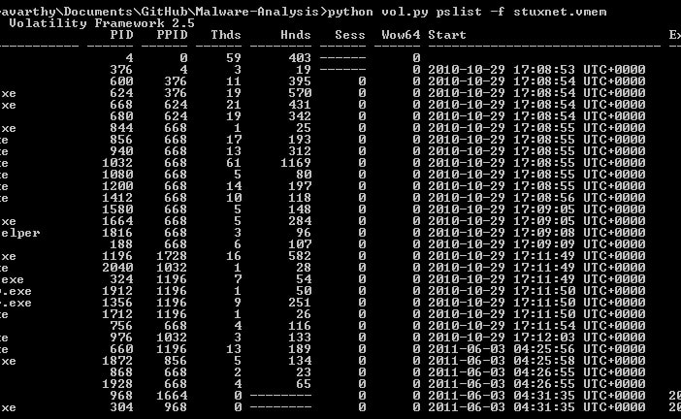
Volatility – Functionalities & Configuration
Memory Analysis Capabilities: Volatility is a powerful tool for memory forensics, enabling the extraction of valuable information from volatile memory.
Malware Analysis and Detection: Facilitates the analysis and detection of malware by examining memory artifacts, providing insights into malicious activities.
Reconstructing System Activities: Aids in reconstructing system activities and identifying suspicious behaviour through memory analysis.

Slide 8

Steghide & John the Ripper
StegHide is a tool used for steganography analysis, allowing forensic examiners to extract hidden information within digital media.
John the Ripper is a powerful password-hash-cracking tool, essential for decrypting passwords and accessing protected data during forensic investigations.

Slide 9

Scalpel
used for recovering files based on their headers, footers, and internal data structures.
Scalpel scans a disk image or a directory of files, looking for specific patterns that define the beginning (header) and end (footer) of particular file types.
It comes with a configuration file that contains predefined file headers and footers for various file types such as JPEG, PDF, DOC, etc. Users can add or modify this configuration to support additional file types.
Helps to detect file signatures

Slide 10

SQLITE3
use SQL queries to extract and analyze data from an SQLite database, allowing them to search for specific information relevant to the investigation.
Read SQL files in the disk image

Slide 11
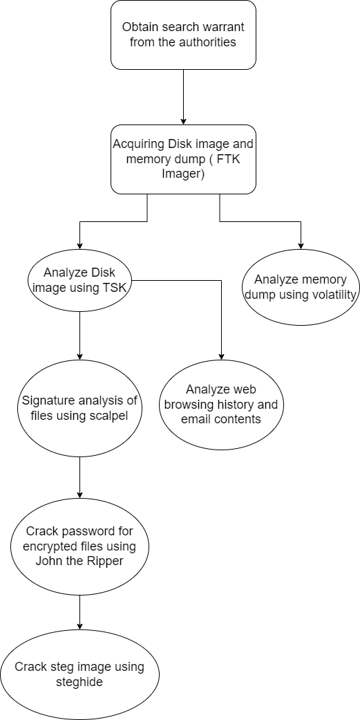
FlowChart

Slide 12
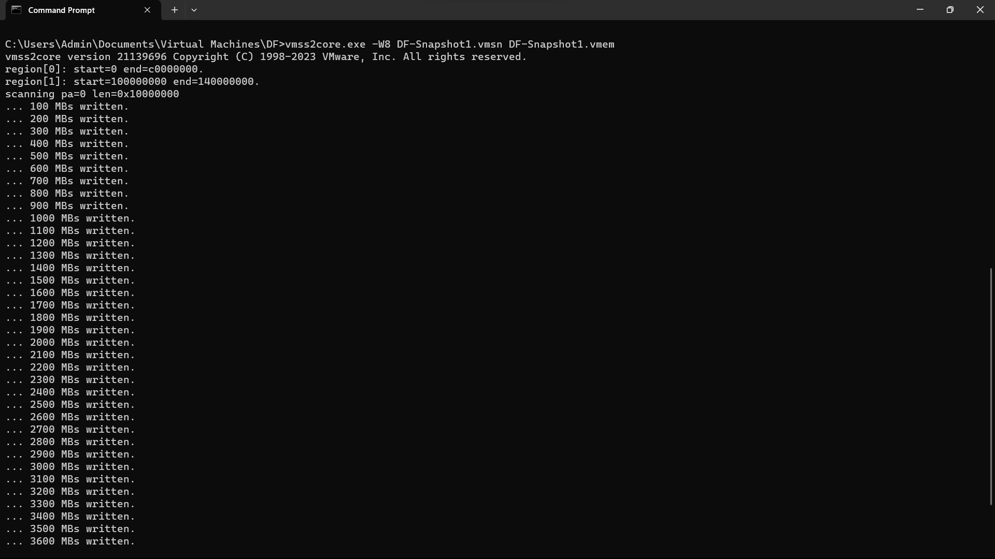
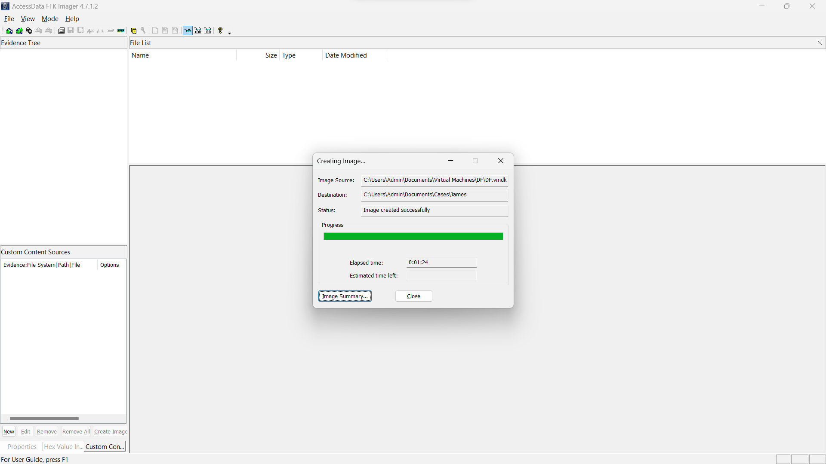
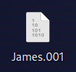
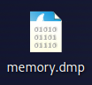
Evidence Acquisition
Evidence acquisition
Disk image capture using FTK imager
Memory dump using VMSS2core.exe

Slide 13
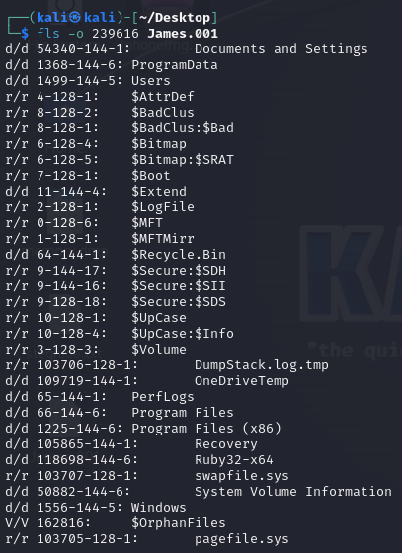
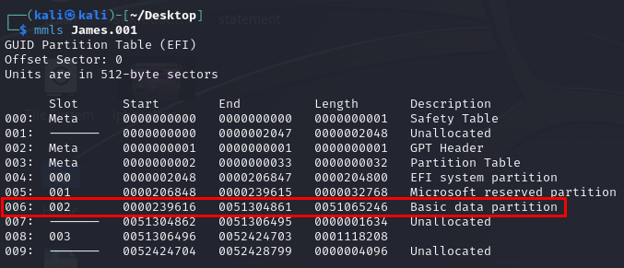
Analyze Disk with TSK
Partition Table of the Disk
Root Folder of the Partition

Slide 14
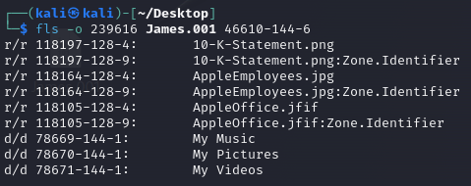
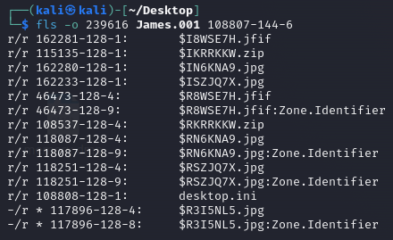
Analyze Disk with TSK
Investigation Process
Documents
Interesting Findings:
Recycle bin has 5 files
Documents has 3 files
Recycle bin

Slide 15
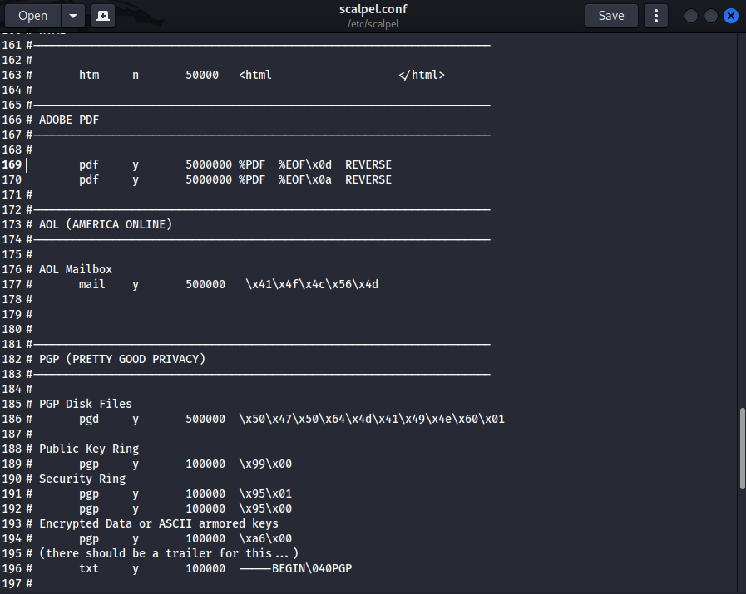
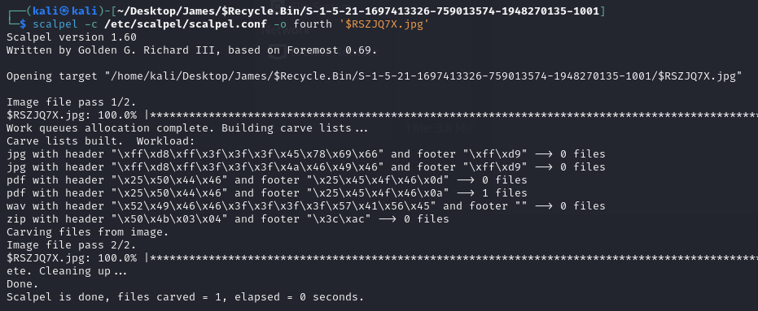
Signature analysis of files with Scalpel
Investigation Process
Configuration to allow JPG and PDF file signature analysis
2. File signature scanning

Slide 16
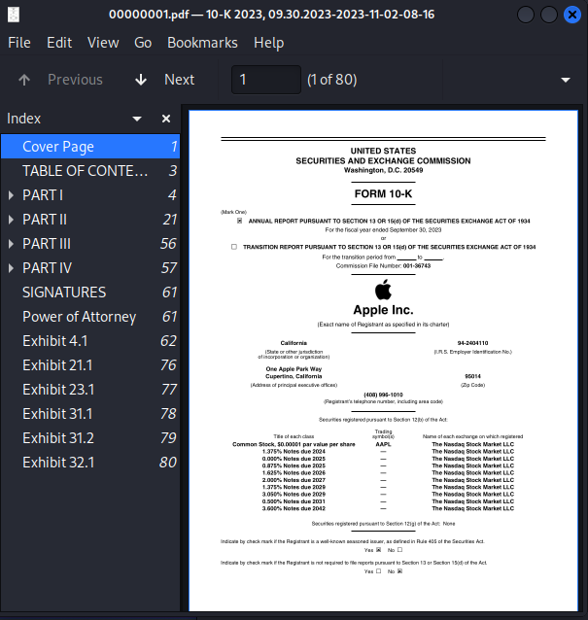
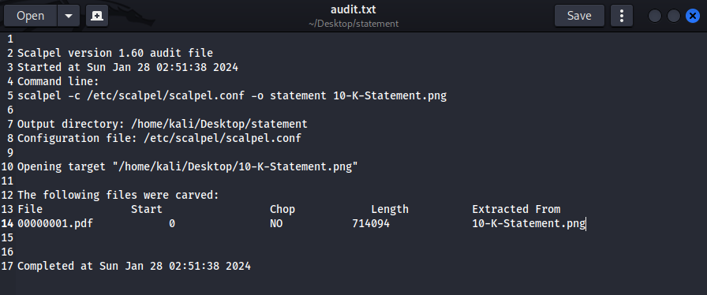
Scalpel Signature analysis findings of documents
We carved out a PDF file hidden under a file with the PNG extension.

Slide 17
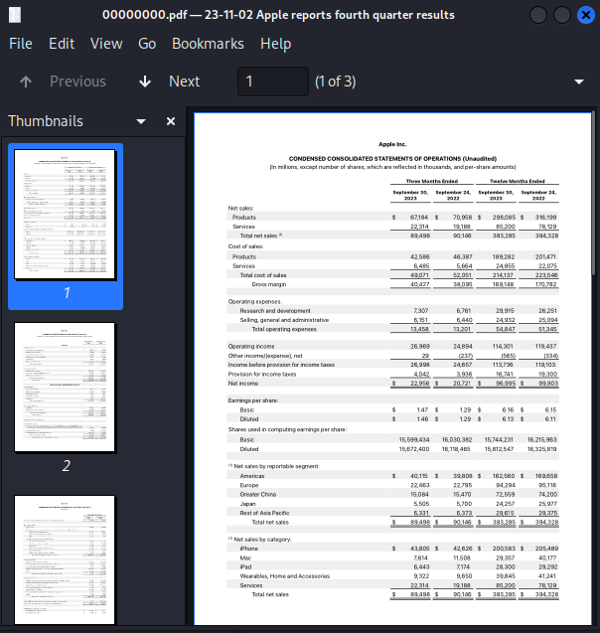
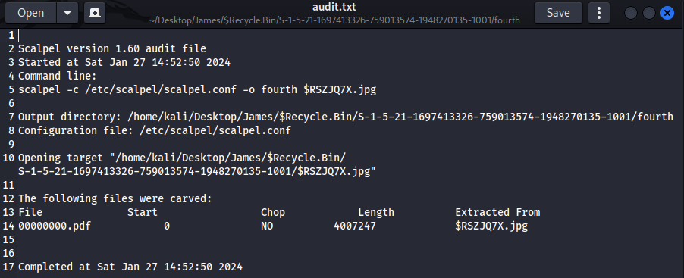
Scalpel Signature Evidence Findings of recycle bin
We carved out a PDF file hidden under a file with the JPG extension.

Slide 18
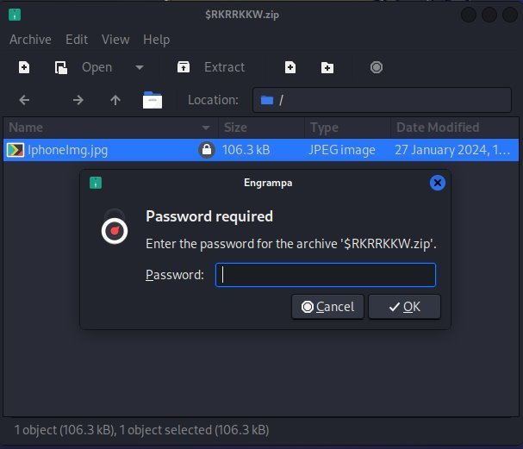
John the ripper
Investigation Process
The zip file found in the Recycle Bin was encrypted and password protected
We need to crack the password using a tool, John the Ripper to access its contents by bruteforcing a wordlist
Find the evidence within.

Slide 19
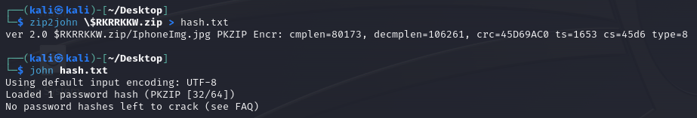
John the Ripper Configuration Process
Get password hash of the zip2john <file>
Use john to crack the hash using its wordlist

Slide 20
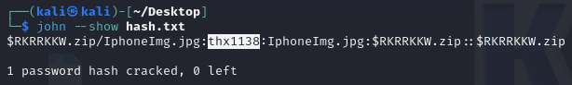
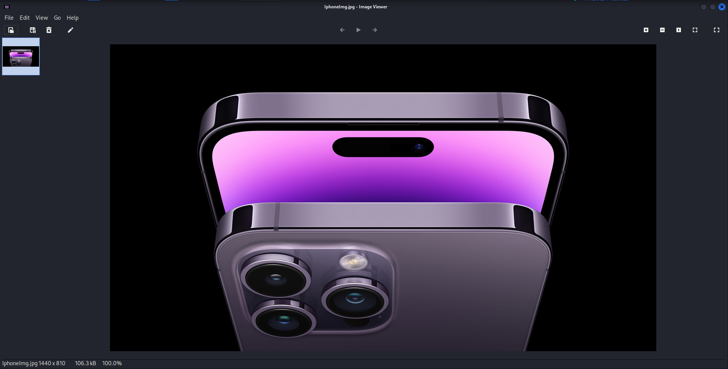
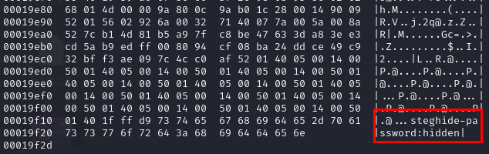
John the Ripper evidence findings and
Results show an image file located within the zip
hexdump revealed a suspicious string at the end of the file
Although it was not reported as stolen data however it is worth to keep it for further analysis later on if needed

Slide 21
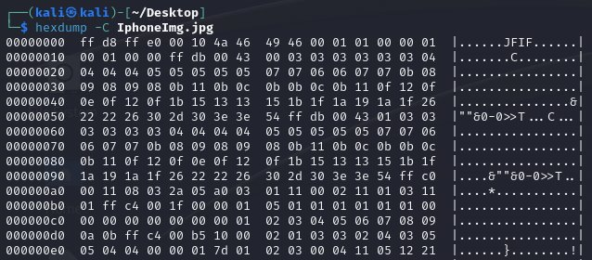
Documentation and Reporting for TSK and Scalpel file analysis
Files from Documents and Recycle Bin
File signature analysis revealed 2 images that were suspicious which later revealed to be PDF files containing the company financial reports
Cracked zip file revealed to be an ordinary company product image
Suspicious string in HexDump at the back of the file

Slide 22
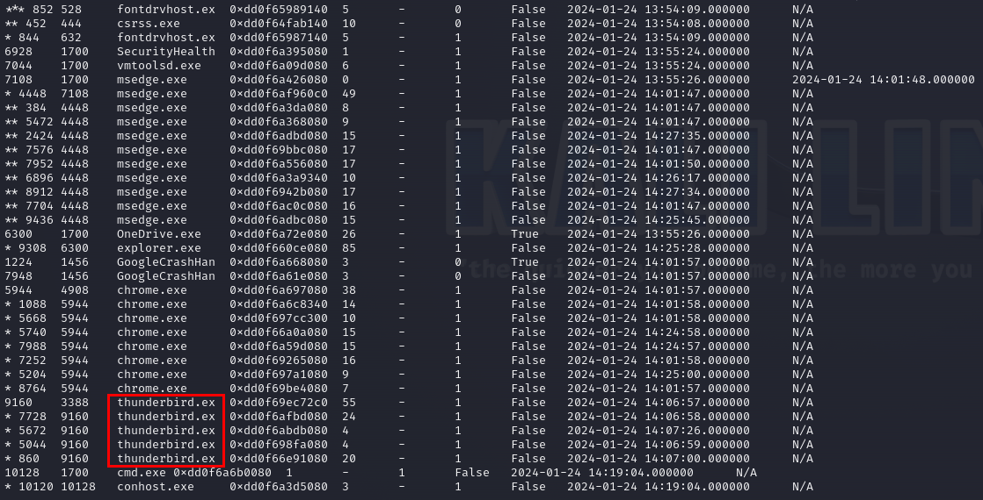
Volatility Analysis
Run windows.pstree command to see running processes
Thunderbird.exe spotted and identified to be an email client
Evidence of James using Thunderbird as an email client

Slide 23
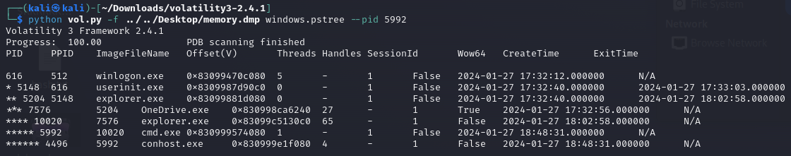

Volatility CMD lines Configuration
Find the PID of cmd.exe
2. Get the memory dump of cmd.exe
3. Display the content of the cmd.exe dump

Slide 24
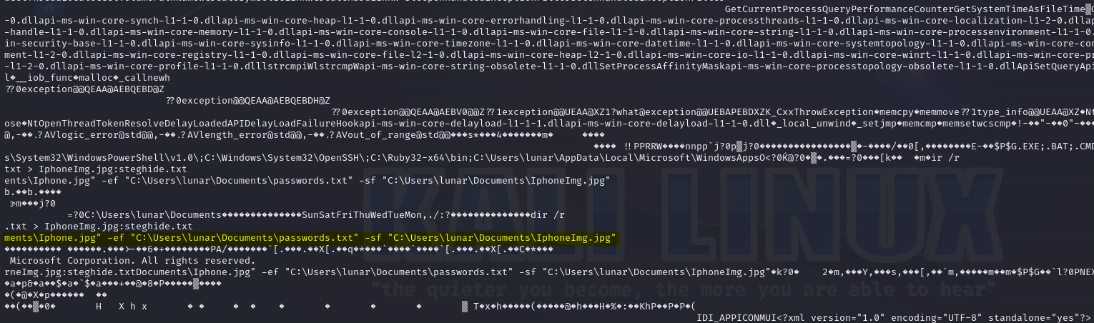
Volatility CMD lines evidence findings
Found fragments of James using CMD lines hide data using steghide with the password.txt with the Iphone.jpg into a JPG called IphoneImg.jpg.
This relates to the earlier finding in the recycle bin where we found the jpg with passwords.txt after using steghide to extract.

Slide 25
Recovery of steghide password and steganography of the suspicious image
Investigation Process
Detect whether image is using steganography
Realised that the image is steg and password protected when trying to utilize steghide
Looking back on the HexDump of the image use the password within it to access the steg image
Use the password to unlock steghide content.

Slide 26
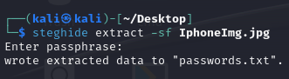
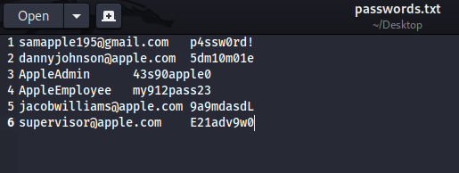
Extracting data using steghide evidence finding
Extracted the hidden steganography file using steghide with the password 'hidden' found in hexdump
We found out there was a passwords.txt hidden which contained the stolen credentials of other Apple workers

Slide 27
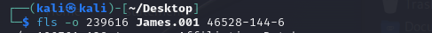
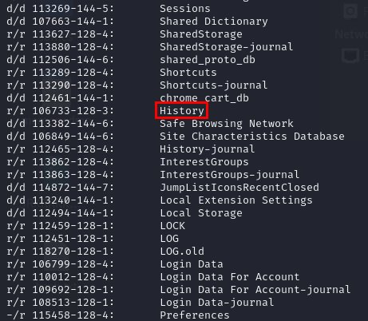
Searching of internet & web browsing artifacts
Investigation Process
Examine Chrome browser history using TSK-C:\..\..\AppData\Local\Google\Chrome\User Data\Default\History
Investigate downloads and searches using sqlite3 shows evidence of steghide and thunderbird search
Suspicious findings such as Beef searches and Company related information gathering was found

Slide 28
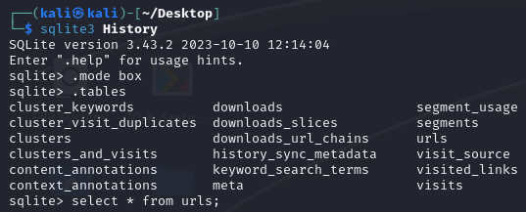
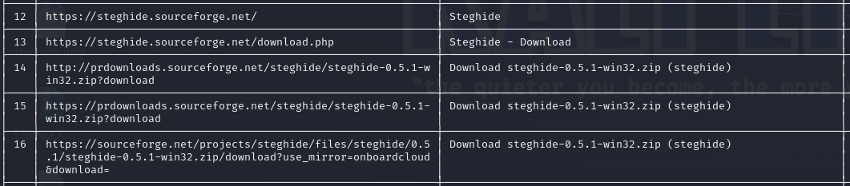
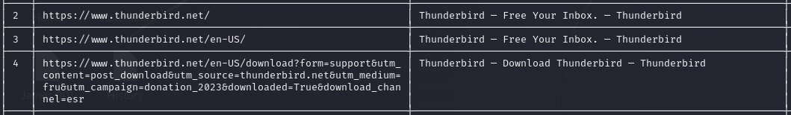
Internet web browsing history evidence findings
Sqlite3 History tables
2. Steghide History
3. Thunderbird History

Slide 29
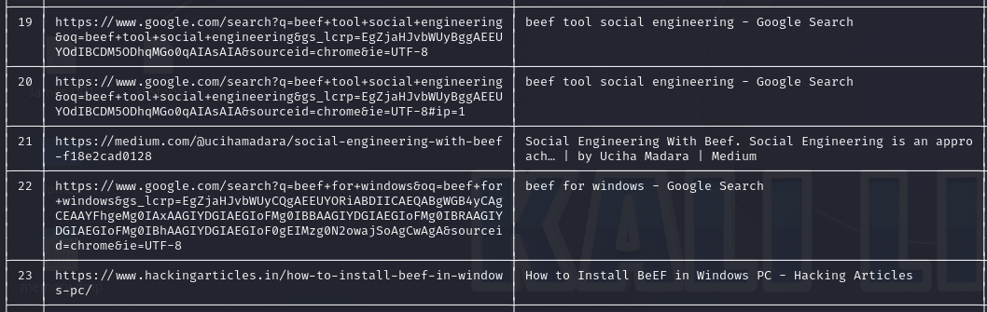
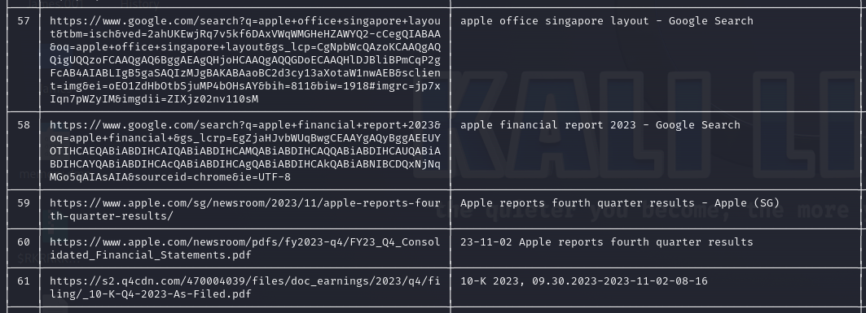
Internet web browsing history evidence findings
Beef searches
Company related searches

Slide 30
Searching of internet & web browsing artifacts Documentation and Reporting
Confirms that James have use tools such as steghide to conceal
Might be using thunderbird email client as a form of communication
Has the intention of gathering company related information and resources.
Beef searches might indicate some form of social engineering James has done to one of the employees
Next step:
Analyze Thunderbird email client using TSK if the suspect was actually using it

Slide 31
Analyze Thunderbird Email data
Access the Thunderbird folder in Program Files
../../AppData/Roaming/Thunderbird/Profiles/xx.default/Mail/pop.gmail.com/
Review Inbox content for phishing emails and communication with the coworker

Slide 32
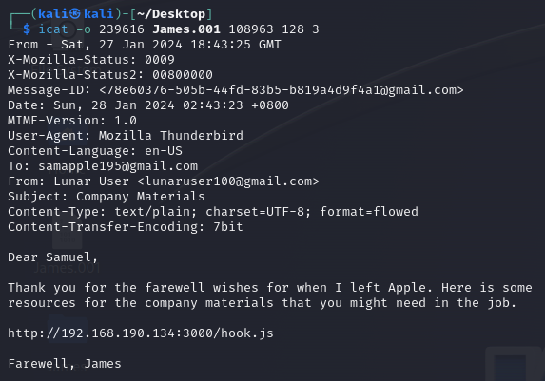
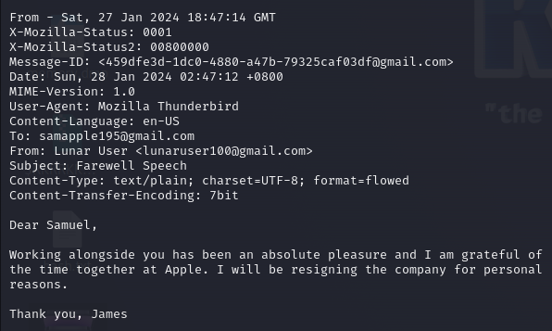
Thunderbird evidence findings
Inbox of Thunderbird
Trash bin of Thunderbird

Slide 33
Email content analysis findings
Suspect James showed evidence of social engineering on one of the company's employees by sending them a Beef link. This is further supported by the beef searches previously found on the web browsing history
One of the features of BeEF is the creation of a malicious link or a "BeEF hook." When a user clicks on a link containing this hook, their web browser becomes connected to the BeEF server. This connection allows the attacker to interact with the user's browser in real-time, exploiting vulnerabilities and potentially being able to steal credentials.

Slide 34
CONCLUSION / REFLECTION
Evidence
Statements
James downloaded and got sensitive data from the company
James performed social engineering techniques on Samuel,One of the employees
James also tried to hide files in the recycle bin and documents by changing their signatures and even resorted to steganography to hide information within image files
Shown in the web-browsing History and Documents and Recycle bin content
Web-browsing search on Steganorgraphy and CMD lines showcasing usage of steghide to hide data
Web browsing BeEf History searches and email content found in the trash bin containing evidence of social engineering attempt by james
James is guilty of stealing confidential information!

Slide 35

THANK YOU!!!

